Slide 1
Introduction to Constrained Optimization
Lecture 1
Prof. Chris Makler
Econ 50 | Stanford University
January 5, 2016
Notes:
Mention class participation

Slide 2
Today
Hour 1: Lecture
Hour 2: Group Work
Introductions
Econ 50 in context
Class policies
Upcoming deadlines
Two Main Analytical Tools:
1. Constrained optimization
2. Comparative Statics

Slide 3
Introductions: about you
How many prospective econ majors? What other majors?
What are you hoping to get out of this course?
What have you heard about this course?
What do you like about econ? What don’t you like?

Slide 4
Introductions: About me
B.A. in humanities, Ph.D. in economics
Main interest: economics education, microeconomics, matching
Courses taught at Stanford: 1A, 50, 51, 167 (Industrial Org.)
Professional life: education technology startups, Aplia, SRI
Current project: econgraphs.org

Slide 5
Econ 50 in Context
What is it actually?
How does it differ from Econ 1?
How does it prepare you for Econ 51, 52, and the major?

Slide 6
What is Econ 50 about?

Slide 7
Econ 50 is about how individual
economic agents
(consumers, firms)
make choices
“optimal”

Slide 8
Consumer optimization:
Deriving demand curves from preferences, budgets
Extensions: intertemporal choice, labor supply
Producer optimization:
Deriving cost curves from production technologies
Deriving supply curves from those cost curves
Optimization with market power:
Monopoly, monopsony, cartel profit maximization

Slide 9
How does Econ 50 differ from Econ 1?

Slide 10
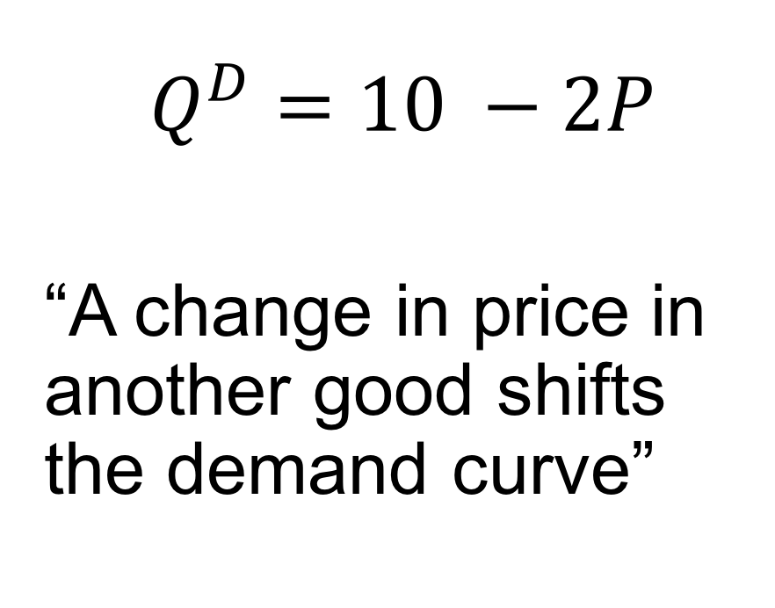
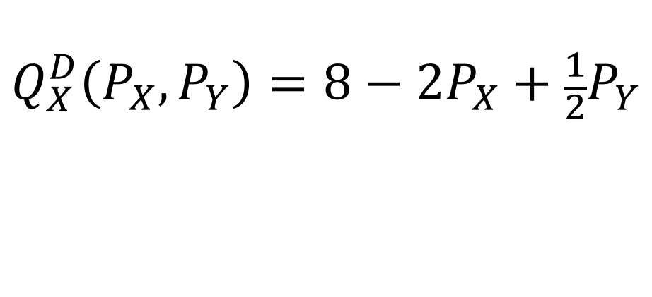
Demand
Econ 1
Econ 50
$$Q^{D}=10 −2P$$
“A change in price in another good shifts the demand curve”
$$Q_{X}^{D}\left(P_{X}, P_{Y}\right)=8−{2P}_{X}+\frac{1}{2}P_{Y}$$

Slide 11
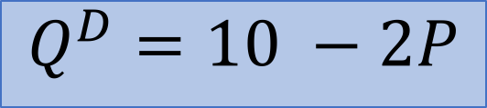
$$Q^{D}=10 −2P$$
Price
Quantity Demanded

Slide 12
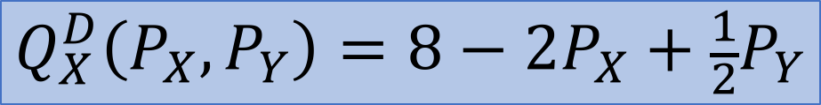
$$Q_{X}^{D}\left(P_{X}, P_{Y}\right)=8−{2P}_{X}+\frac{1}{2}P_{Y}$$
Price of Good X
Quantity Demanded of Good X

Slide 13
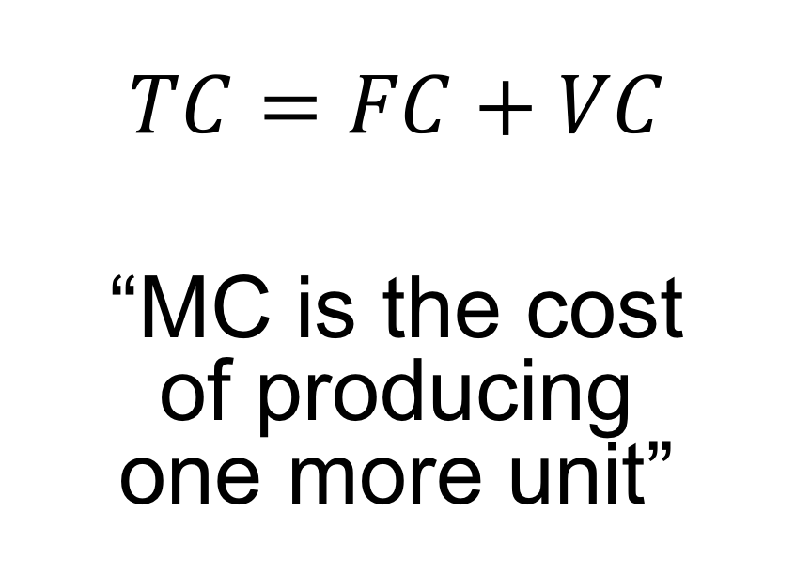
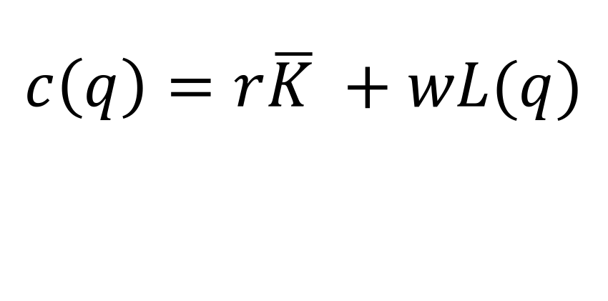
Total and Marginal Cost
Econ 1
Econ 50
$$TC=FC+VC$$
“MC is the cost of producing one more unit”
$$c\left(q\right)=r\overline{K} +wL(q)$$

Slide 14
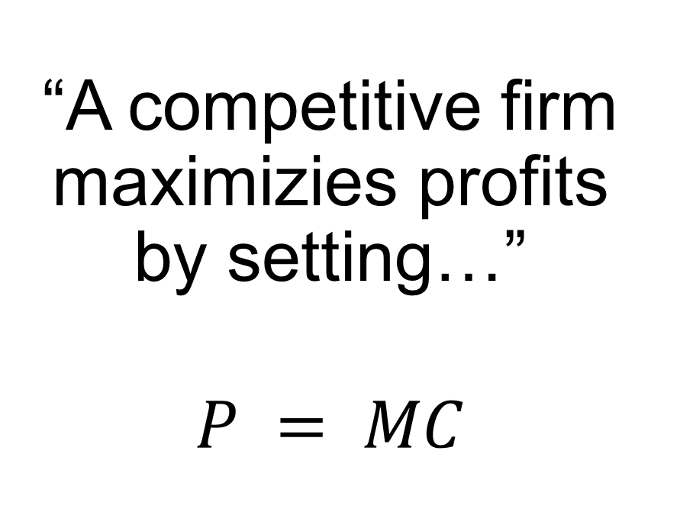
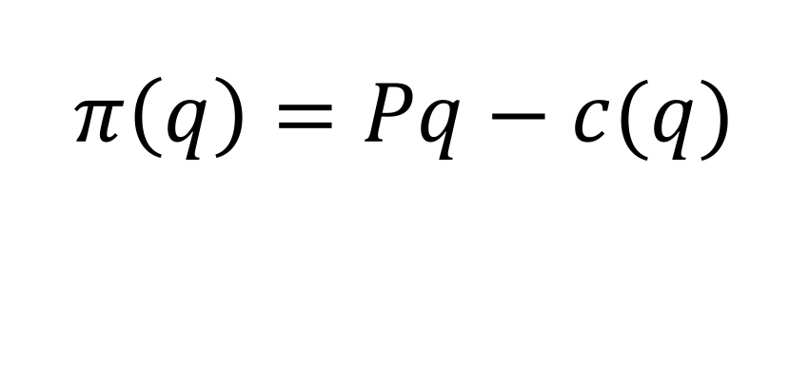
Profit Maximization
Econ 1
Econ 50
“A competitive firm maximizies profits by setting…”
$$P = MC$$
$$π\left(q\right)=Pq−c(q)$$

Slide 15
How does Econ 50 lead into Econ 51 and 52?

Slide 16
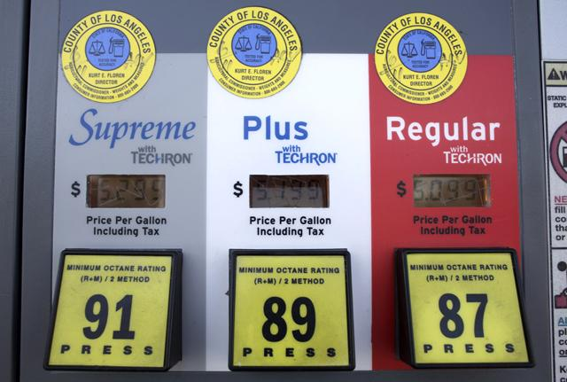
INDIVIDUALS
MARKETS
ECONOMIES
Econ 50
Econ 51
Econ 52

Slide 17
Econ 50: Models of optimization
Econ 51: Models of interaction
Econ 52: Models of policy
Throughout: Comparative Statics
– response to change

Slide 18
Class Policies
All the details are in the syllabus; read it carefully!

Slide 19
Textbooks
David Besanko & Ronald Braeutigam
Microeconomics, 5e
More basic than the course
Required; used for HW problems, readings
Hal Varian
Intermediate Microeconomics: A Modern Approach, 8e
More advanced than the course
Optional; useful if you are serious about econ

Slide 20
Lectures 1-3 | Modeling tools | B&B Ch. 1-2
Lectures 4-7 | Consumer choice | B&B Ch. 3-4
Lectures 8-11 | Deriving demand | B&B Ch. 5
Midterm: February 11 (in class)
Lectures 12-14 | Producer choice | B&B Ch. 6-8
Lectures 15-17 | Deriving supply | B&B Ch. 9-10
Lectures 18-19 | Market power | B&B Ch. 11
Final: March 16, 12:15-3:15pm

Slide 21
Hour 1: Lecture
Hour 2: Group Work
Purpose: build intuition
PowerPoint, interactive graphs, derivations, discussion
NO LAPTOPS OR PHONES
Purpose: build facility
Problems similar to HW/tests, simulations, games
LAPTOPS CAN BE USEFUL

Slide 22
Section: Every Friday
Every Friday starting 1/15; no section 2/12
Purpose: practice and feedback
Great participation can “bump” your grade
Join via Coursework

Slide 23
Homeworks: 25% of grade
Due every Friday at beginning of section, starting next week
If you have to miss section, may be submitted online or by fax by 10am
No extensions, but your lowest score is dropped

Slide 24
Midterm: 30% of grade
Thursday, February 11, in class
No makeup exams. If you cannot take the midterm, your grade will be based on HW & final – but you must let me know this before the exam!

Slide 25
Final: 45% of grade
Wednesday, March 16, 12:15-3:15pm.
No makeup finals. Any accommodations (e.g., athletes traveling) must be made ahead of time.

Slide 26
Formal policies
Students with disabilities: studentaffairs.stanford.edu/oae
Econ department common syllabus: economics.stanford.edu/undergraduate/economics-common-syllabus
Regrade requests must go to DUS, not me.

Slide 27
Online Resources
Coursework: all class logistics (sections, homework, etc)
coursework.stanford.edu/portal/site/W16-ECON-50-01
Piazza: all class communication (announcements, questions)
piazza.com/stanford/winter2016/econ50
EconGraphs: all course materials (slides, interactive graphs)
econgraphs.org/courses/stanford/W16-ECON-50

